Slide 1
ANN for Concrete Strength prediction

Slide 2
Different Numbers of Layers and Nodes
Number of Layers: 1 - 6
Number of neurons : 1 - 64
Activation Function : hyperbolic tangent

Slide 3
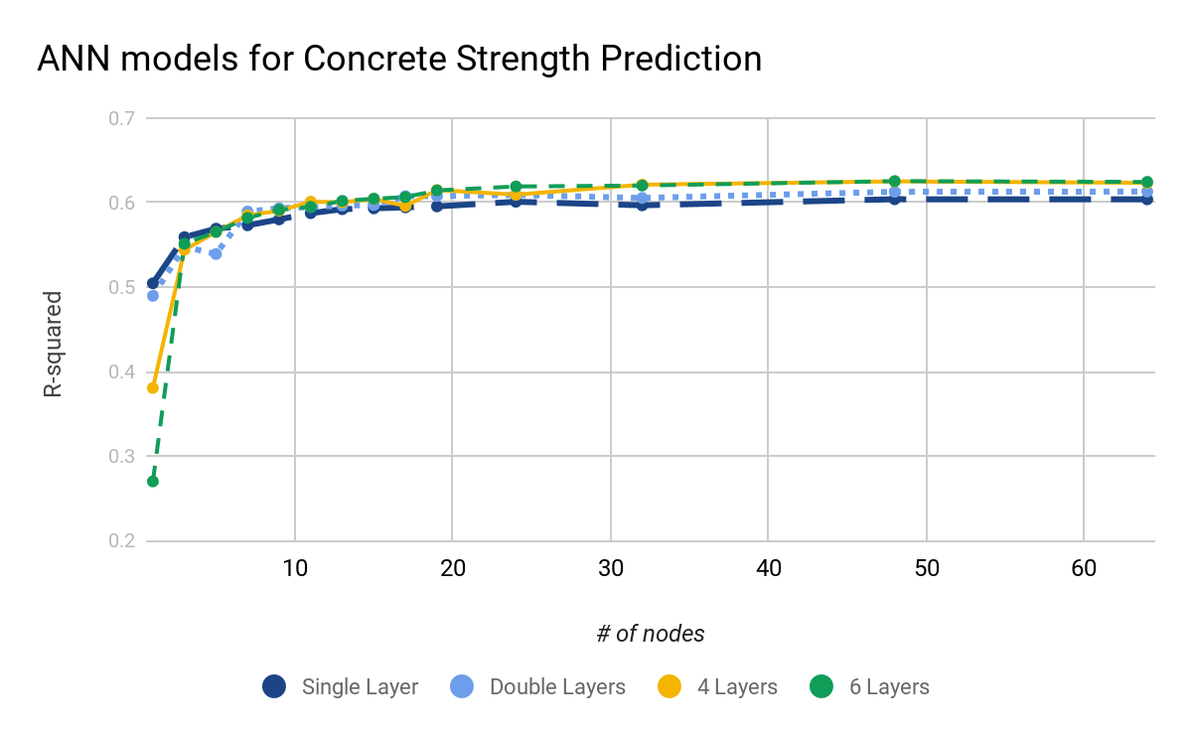
Different Numbers of Layers and Nodes

Slide 4
 | Best R-Squared
Single layer | 0.6039
Double layers | 0.6130
4 layers | 0.6251
6 layers | 0.6254

